Slide 1

Recruit. Train. Certify. Deploy.
+

Slide 2

OVER A DECADE OF LARGE-SCALE DEPLOYMENT
FOUNDED
PROVEN SUCCESS
OUR PURPOSE
Founded in 2002, SkillStorm specializes in providing services and cleared personnel trained on leading edge technology.
Experience executing high-impact projects and strengthening information security efforts for the federal government.
Strategically placed over 3,000 technology professionals in the federal and commercial space.
We specialize in technologies that are in high demand, and consistently source, train and deliver in challenging client locations.
Close the constant demand and supply technology skill set gap in North America, with a focus in the federal sector.
Help our nation and the companies that work in support of our government attract and retain top technical talent.

Slide 3
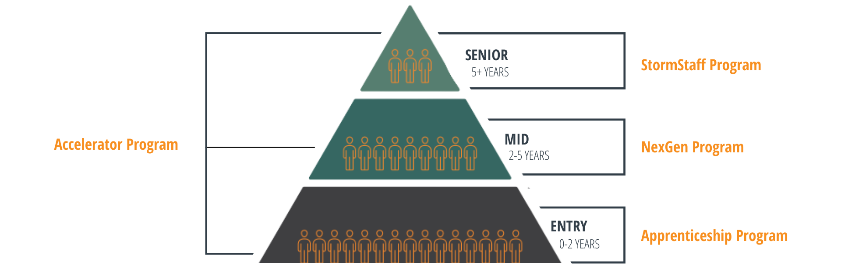
SKILLSTORM SERVICE OFFERINGS
Through client collaboration, we are able to build and deploy a reliable, exclusive pipeline of high-quality U.S.-based tech talent with the skills and clearance levels required to support critical technology initiatives.
We're creating the surging tech force U.S. businesses and government agencies need to lkl;kl, accelerate and advance.
95%
of our clients are Fortune 500 industry leaders
5,000+
Hired, trained, and deployed tech experts to U.S. government agencies
3 OF 5
U.S consulting firms hire new talent from SkillStorm

Slide 4







TECHNOLOGY CAPABILITES
DEVELOPMENT
DEVOPS
SDET
CLOUD & PLATFORM
Front-end
Angular
AngularJS
React
Ajax
JavaScript
HTML
CSS
jQuery
iOS
Swift
Android
Kotlin
Middle-tier
Java
Servlets
Spring
Spring Boot
Hibernate
Spring Data
JDBC
REST
SOAP
Express
NodeJS
Back-end
SQL
MySQL
Oracle
PostgreSQL
MongoDB
Java
Maven
Jenkins
CI/CD
Docker Kubernetes Sonarqube
Cloud
Ansible
Chef
Puppet
Terraform
Java
Selenium Cucumber TestNG Postman
Soap UI
JUnit
JavaScript
Jasmine
Protractor
Karma
Jest
Cloud
Platform

Slide 5

























Slide 6

TECH TALENT SERVICES
Apprenticeship Program
Designed to develop transitioning service member (TSM) into experienced IT professionals through our 36-month apprenticeship program.
NexGen Program
Our 10-12 week program provides the flexibility to customize training per technology stack, tailored specifically to our client’s needs.
Accelerator Program
We upskill technologists to become specialists in technology stacks such as AWS, Salesforce, Pega and ServiceNow.
StormStaff Program
We are a provider of highly qualified, experienced and lead technologists in all technology stacks to solve your immediate challenges.

Slide 7

TRAINING FEATURES
Authorized to work in U.S.
All U.S. Citizens and Green Card Holders
Security Clearances
Many hold specific clearances based on client needs
Education and Experience
All candidates meet minimum education and experience requirements.
Customized Training & Certifications
Trained to client's specific needs and become industry certified on multiple levels
Two Year Commitment
Each Software Engineer is committed to working for our clients for a minimum of 2 years.

Slide 8


QUESTIONS?
NAME
000.000.000
@skillstorm.com
www.skillstorm.com
10151 Deerwood Park Blvd. Jacksonville, FL, 32256

